Slide 1
2nd semester
U.S. History

Slide 2
Links to Main Sections
(Click on the links to move to a Era)
The 1940s – World War II
1950s Foreign Policy
1950s Domestic Policy
1960s Foreign and Domestic Policy
Civil Rights and other Social Movements
The 1970s
The 1980s – 2000s

Slide 3

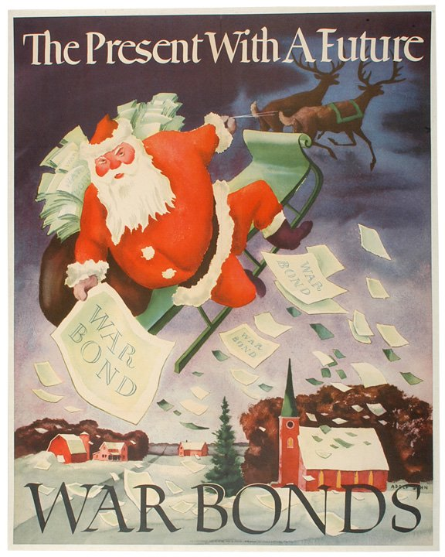
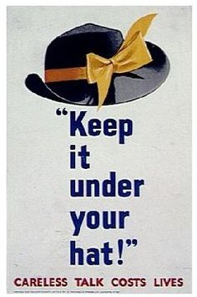

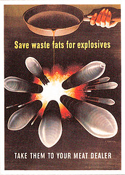
The 1940’s world war ii
U.S. History

Slide 4
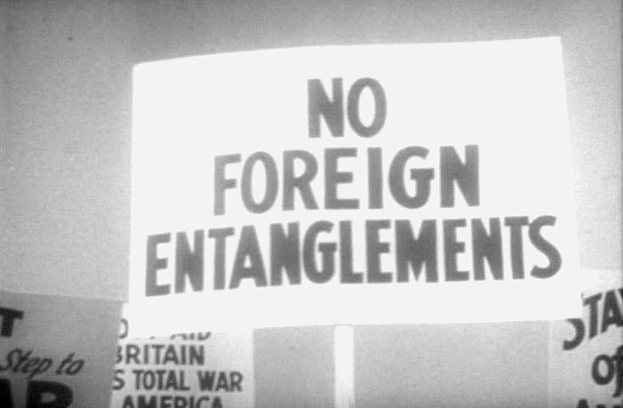
Isolationism
Opposition to political and economic entanglements with other countries.

Slide 5
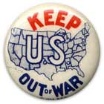
Neutrality Acts 1930’s
A series of laws enacted in 1935 and 1936 to prevent U.S. arms sales and loans to any nation at war or any nation having a civil war.

Slide 6
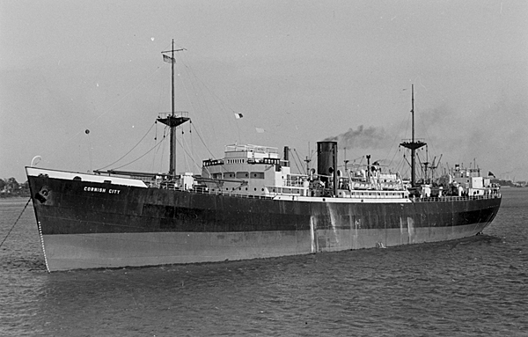
Cash and Carry
U.S. policy that allowed for the sale of non-military goods to any nation at war as long as they paid cash for the goods up front and than moved the goods on their own ships.

Slide 7
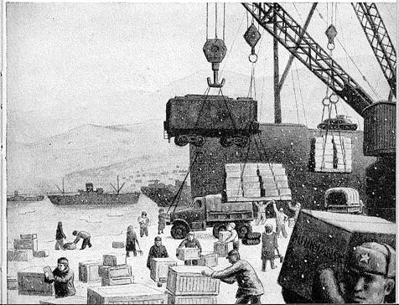
Lend-Lease Act, 1941
Authorized the president to transfer, lend, or lease any article of defense equipment to any government whose defense was deemed vital to the defense of the U.S. Allowed the U.S. to send supplies and ammunition to the Allies.

Slide 8

Nazism
The political philosophy-based on extreme nationalism, racism, & militaristic expansionism- that Adolph Hitler put into practice in Germany from 1933 to 1945.

Slide 9

Fascism
A political philosophy found in Italy during W.W.II that advocated a strong, centralized, nationalistic government headed by a powerful dictator.

Slide 10
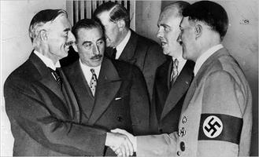
Appeasement
A granting of concessions to a hostile power in order to keep the peace. This is what Britain and France did in 1939 when they allowed Hitler to take Czechoslovakia.

Slide 11
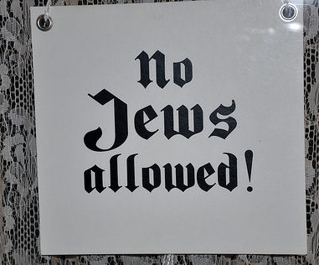
Anti-Semitism
Prejudice and discrimination against Jewish people as found in Nazi Germany during the 1930’s and the 1940’s.

Slide 12
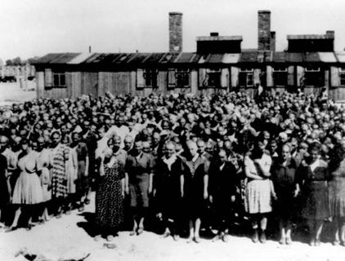
Genocide
The deliberate and systematic extermination of a particular racial, national, or religious group.

Slide 13
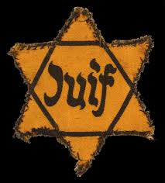
Holocaust
The systematic murder of 11 million Jews and other people by the Nazis before and during World War II.

Slide 14
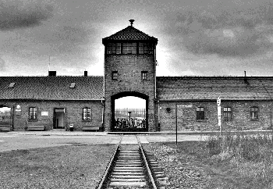
Final Solution
Unable to rid Germany of its Jews by forcing them to leave, the Nazi’s adopted this new approach in 1939 in which all Jews were rounded up and either sent to slave labor camps or to extermination camps.

Slide 15
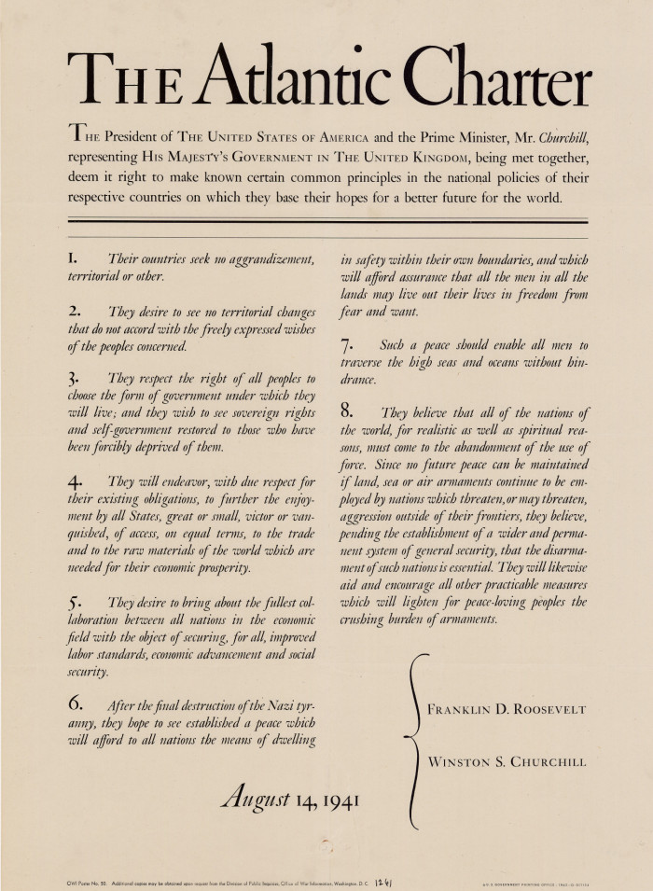
Atlantic Charter
A 1941 declaration of principles in which the U.S. and Great Britain set forth their goals in opposing the Axis powers in W.W.II.

Slide 16
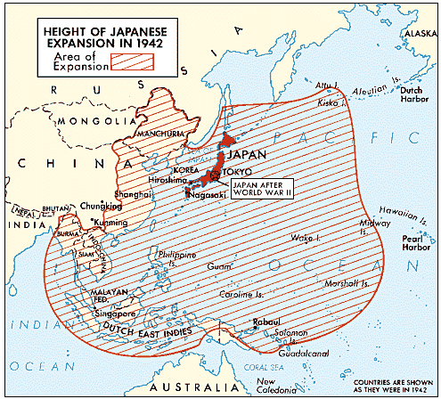
Japanese Expansion
Japan’s military invaded and took over vast parts of Southeast Asia and hundreds of islands across the Pacific in order to create a vast empire for its growing population that need more living space.

Slide 17
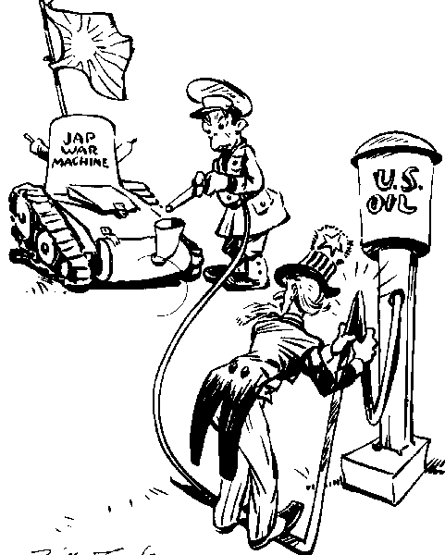
Embargo
A government ban on trade with one or more other nations. The U.S. did this in the summer of 1941 when it stopped all oil sells to the Empire of Japan.

Slide 18
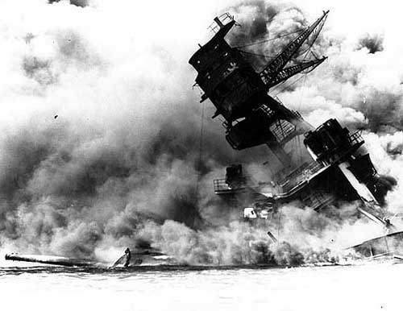
Pearl Harbor, December 7, 1941
Surprise attack by Japanese on U.S. Pacific Fleet harbored in Pearl Harbor, Hawaii. The U.S. declared war on Japan and Germany, entering World War II.

Slide 19
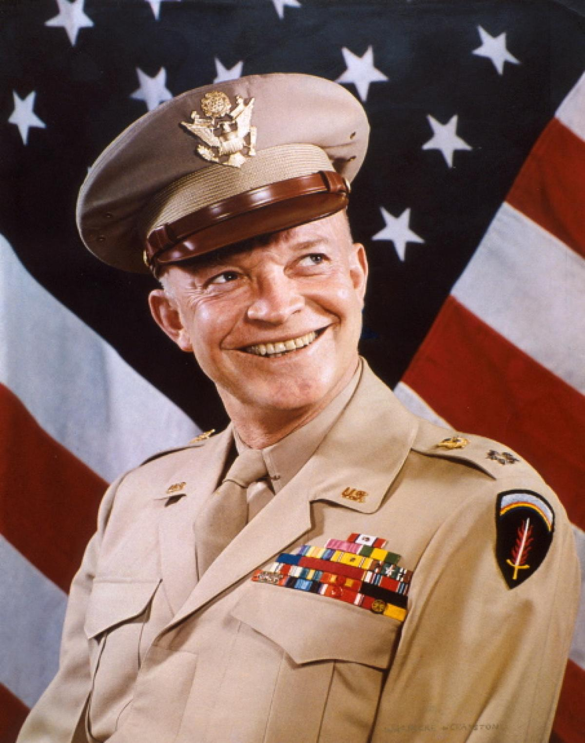
General Dwight D. Eisenhower
Famous W.W. II U.S. Army General who led Allied forces in Europe & North Africa and planned the D-Day invasion in June 1944. He later became President of the U.S. from 1953-1961.

Slide 20
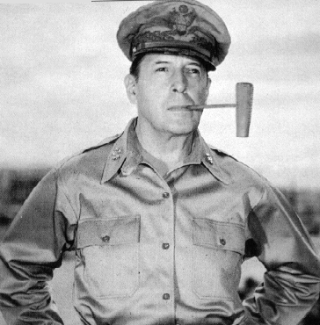
General Douglas MacArthur
U.S. Army General that led U.S. forces in the Pacific to victory after victory against the Japanese.

Slide 21
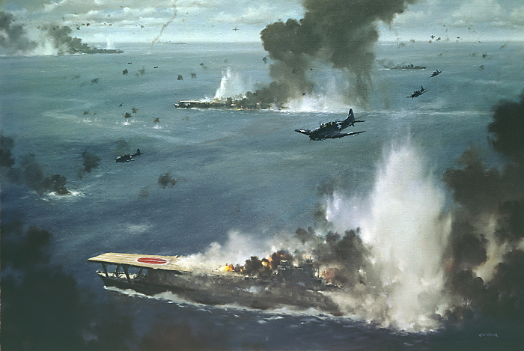
Battle of Midway 1942
Turning point of World War II in the Pacific, in which the Japanese advance was stopped by the U.S.

Slide 22
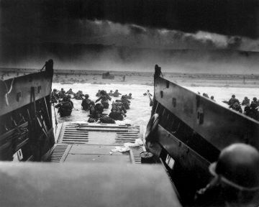
D-Day, June 6, 1944
Led by Eisenhower, over a million troops (the largest invasion force in history) stormed the beaches at Normandy and began the process of re-taking France. The turning point of World War II.

Slide 23
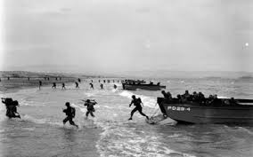
Normandy
Region in northwestern France where on 6 June 1944 Allie forces landed on the beaches of the English Channel to begin the invasion of Nazi- occupied Europe during W.W.II.

Slide 24
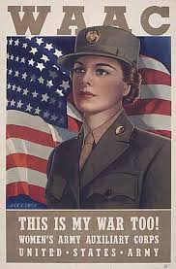
WAACS-Women’s Army Corps
U.S. Army group established during World War II so that women could serve in non-combat roles. This freed up more men to go fight.

Slide 25
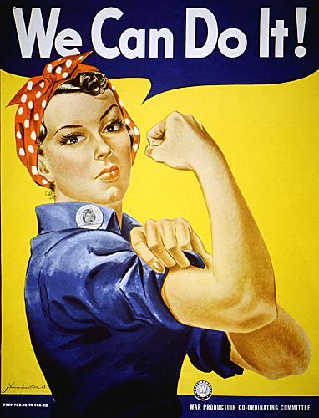
Rosie the Riveter
Women found jobs, especially in heavy industry, that fell outside the traditional realm of women’s work.

Slide 26
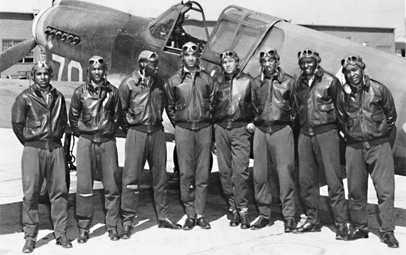
Tuskegee Airmen
The 99th all African-American fighter squadron that escorted bombers in the air over Europe and North Africa during World War II. Nicknamed the Red Tails.

Slide 27
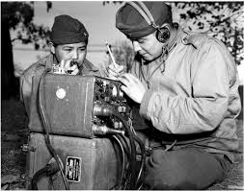
Navajo Code Talkers
The U.S. government used members of the Navajo tribe to send messages in their native language in order to keep U.S. military plans a secret from the Axis powers. They recruited 200 Navajos into the Marine Corps.

Slide 28
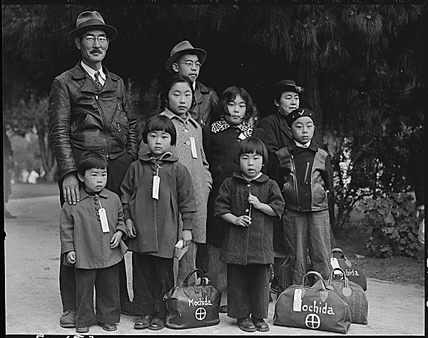
Japanese American Internment
During W.W. II the U.S. government locked up Japanese-Americans in camps in the western U.S. because of fear that they might carry out acts of sabotage or terrorism against the U.S.

Slide 29
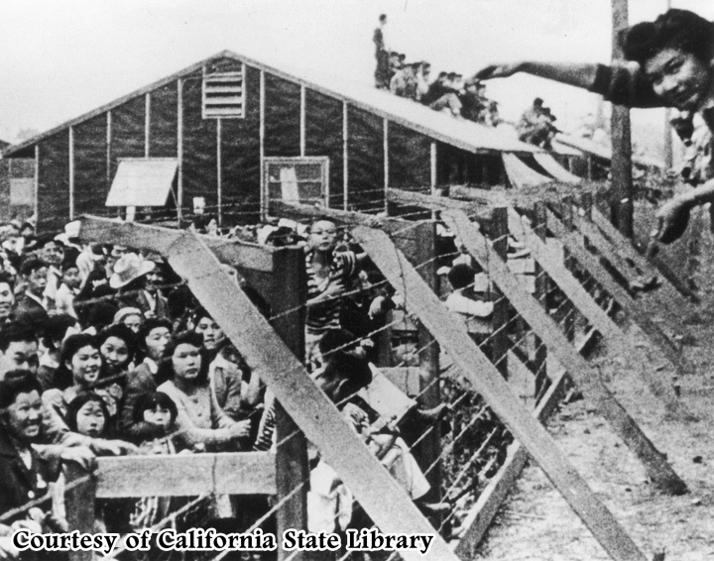
Korematsu v. U.S., 1944
Upheld the U.S. government's decision to put Japanese-Americans in internment camps during World War II.

Slide 30
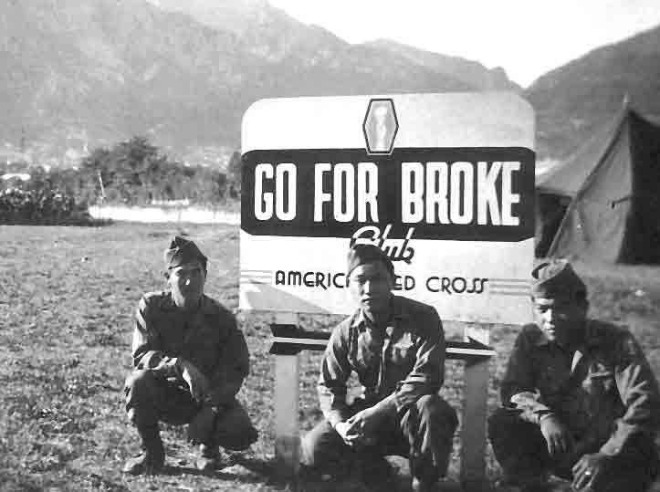
442nd Regimental Combat Team
World War II unit made up of Japanese-American volunteers. They were the most decorated combat unit of the war.

Slide 31

War Production Board
A government agency established during World War II to coordinate the production of military supplies by U.S. industries and factories.

Slide 32
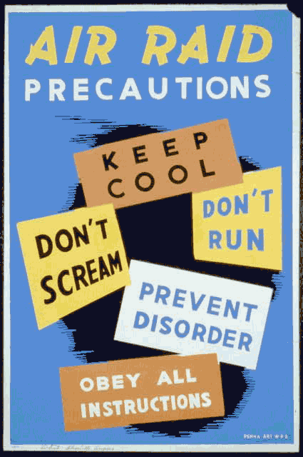
Home Front
The civilian sector of a war that are left at home to support the troops that are off fighting for the homeland.

Slide 33
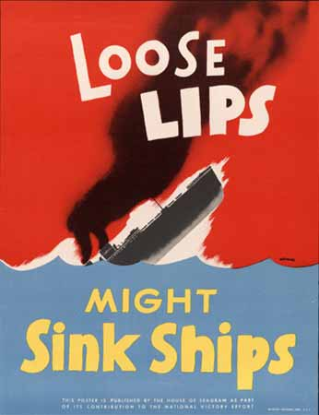
War Posters
The radio, print, and film industries reminded Americans that they were in a struggle between dictatorship and democracy.

Slide 34
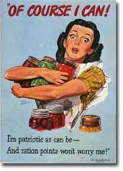
Rationing
A restriction of people’s right to buy unlimited amounts of particular foods and other goods, often implemented during wartime to assure adequate supplies for the military. This would include: meat, gasoline, coffee, shoes, sugar, etc..

Slide 35
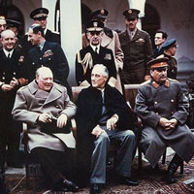
Yalta Conference 1945
A 1945 meeting at which the leaders of the United States, Great Britain, and the Soviet Union agreed on a set of measures to be implemented after the defeat of Germany.

Slide 36
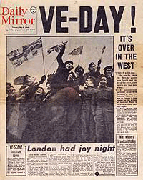
VE-DAY
A name given to 8 May 1945, on which General Eisenhower’s acceptance of the unconditional surrender of Nazi Germany marked the end of World War II in Europe.

Slide 37
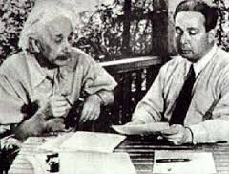
Manhattan Project
The top secret U.S. program to develop an atomic bomb for use in World War II.

Slide 38
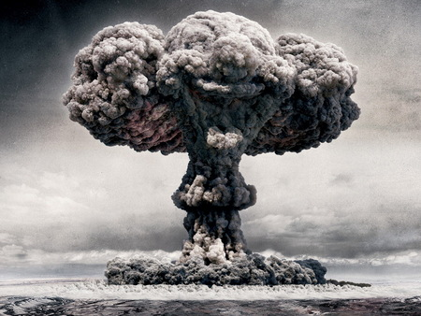
Atomic Bomb
A bomb in which the splitting of atomic nuclei results in an explosion of tremendous force and heat, accompanied by a blinding light- used on Japan to end World War II.

Slide 39
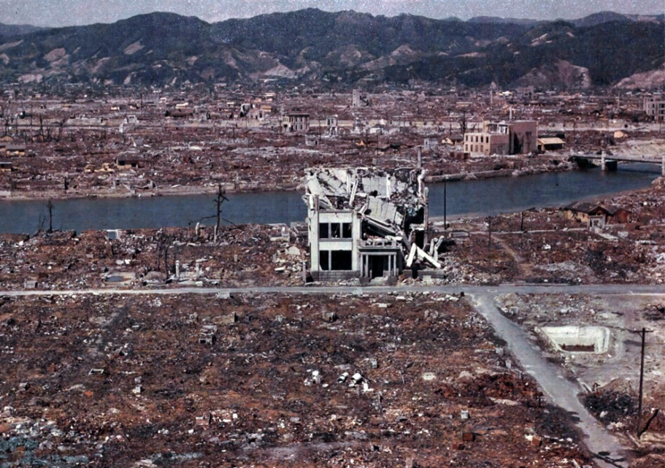
Hiroshima & Nagasaki
The two Japanese cities that the U.S. dropped the atomic bomb on in August & September 1945 to end the war in the Pacific.

Slide 40
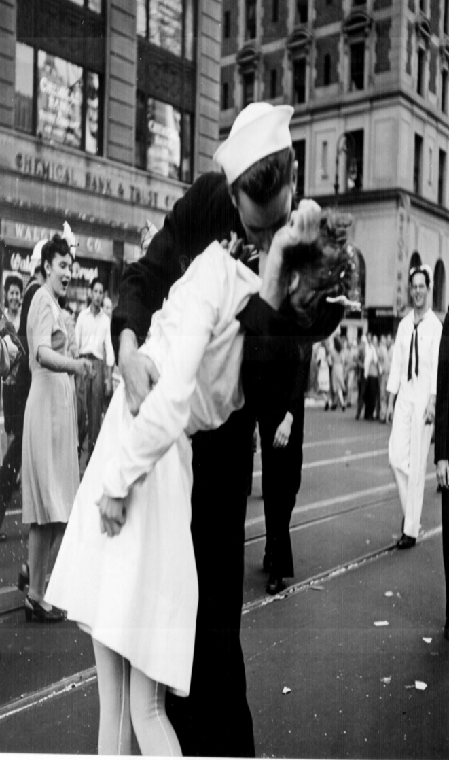
VJ-DAY
September 2, 1945-victory over Japan Day which is the day that Japan surrendered to the U.S. thus ending W.W. II.

Slide 41
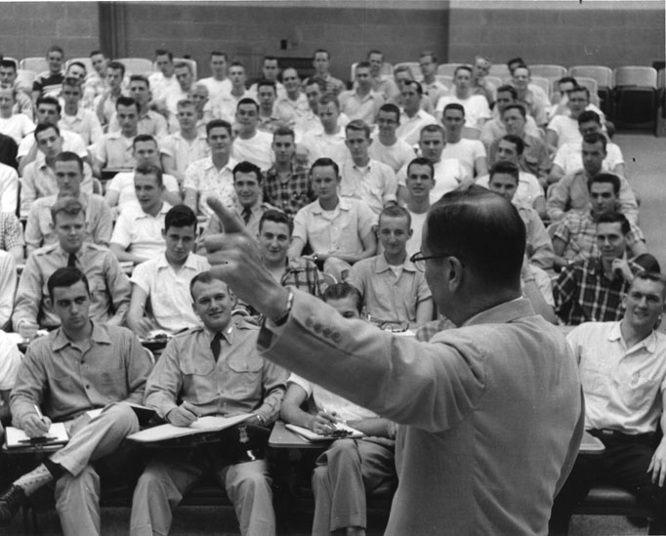
G.I. Bill, 1944
Servicemen's Readjustment Act, also called the G.I. Bill of Rights. Granted $13 billion in aid for former servicemen, ranging from educational grants to housing and other services to assist with the readjustment to society.

Slide 42
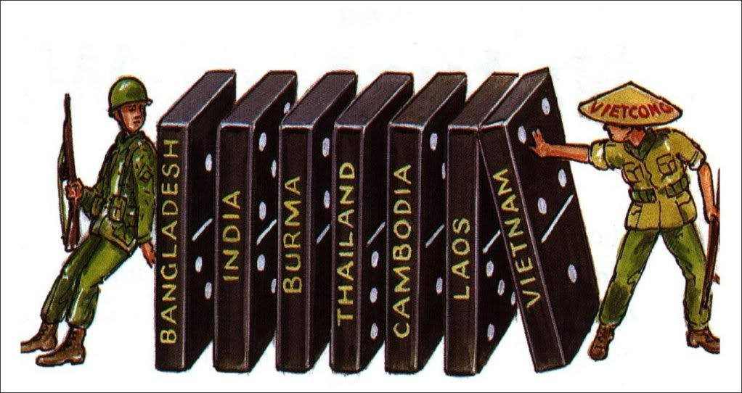
The 1950’s foreign Policy
U.S. History

Slide 43
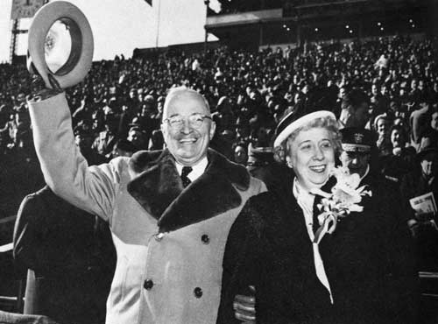
Harry S. Truman
President of the United States from 1945-1953. Frist U.S. president to face the Cold War.

Slide 44
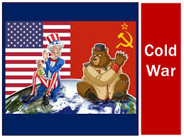
Cold War
A worldwide rivalry and state of hostility, without direct military conflict, that developed between the United States and the Soviet Union after World War II.

Slide 45
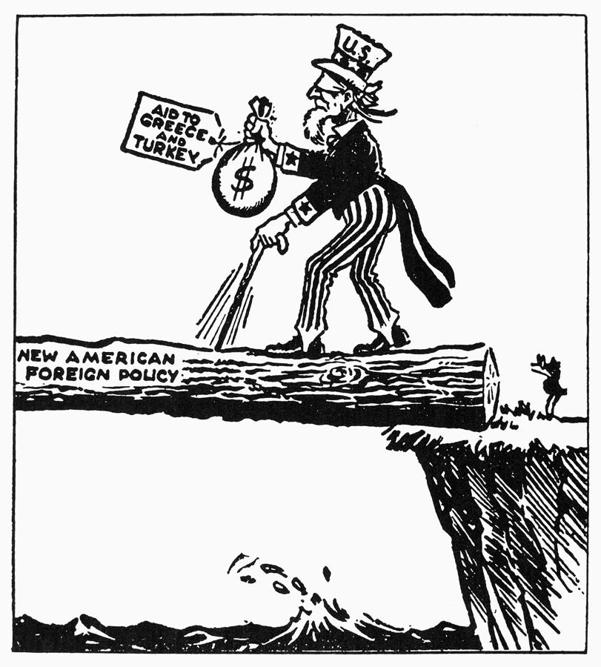
Truman Doctrine
A U.S. policy, announced by President Harry S. Truman in 1947, of providing economic and military aid to free nations threatened by internal or external opponents like the communists. Greece & Turkey were two nations that received help.

Slide 46
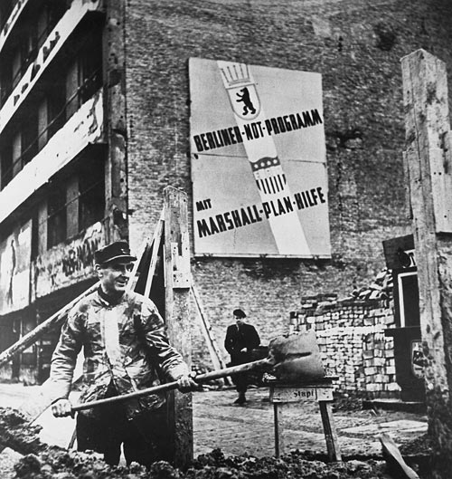
Marshall Plan1947
Introduced by Secretary of State George G. Marshall, he proposed massive economic aid to Europe to revitalize the European economies after WWII and help prevent the spread of Communism.

Slide 47
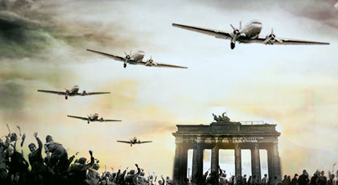
Berlin Airlift
A 327-day operation in which U.S. and British planes flew food and supplies into West Berlin after the Soviets blockaded the city in 1948.

Slide 48
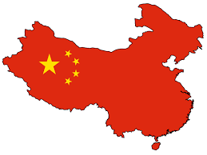
Communist China 1949
In May 1949 after more than 20 years of struggle and civil war the communist Chinese took control of mainland China from the Chinese Nationalist government and declared the People’s Republic of China a communist state.

Slide 49
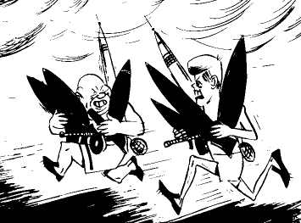
Nuclear Arms Race
Cold War competition between the U.S. & the U.S.S.R. which was a race between the world powers for greater military strength through the building of large numbers of nuclear weapons.

Slide 50
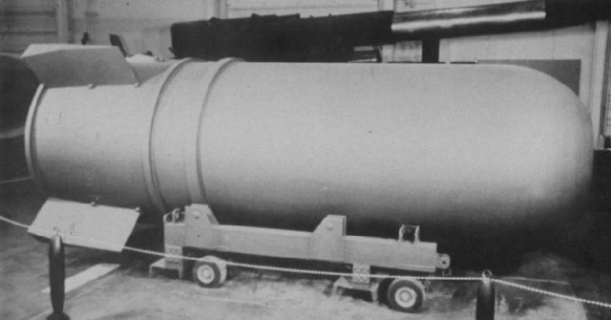
H-Bomb
The hydrogen bomb- a thermonuclear weapon much more powerful than the atomic bomb.

Slide 51

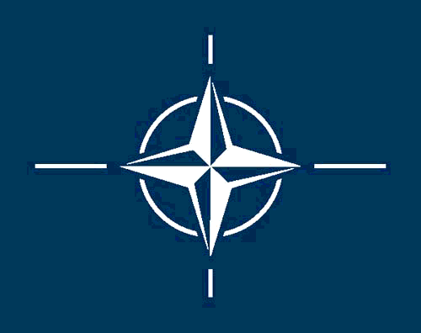

Post-war Organizations
United Nations, 1945 - Founded after WWII by victorious Allied Powers to intervene in conflicts between nations and avoid war.
NATO, 1949 - The member nations agreed to fight for each other if attacked. It is an international military force.
SEATO, 1954 - Alliance of non-Communist Asian nations modeled after NATO. Unlike NATO, it didn't establish a military force.

Slide 52

Warsaw Pact
A military alliance formed in 1955 by the Soviet Union and its Eastern European satellites to counter the NATO military alliance.

Slide 53
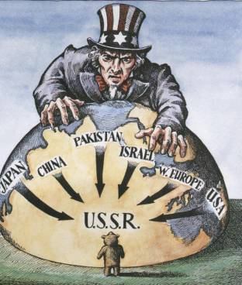
Containment Policy
The blocking of another nation’s attempts to spread it influence- especially the efforts of the United States to block the spread of Soviet influence during the late 1940’s and early 1950’s. Both the Korean War & the Vietnam War were attempts by the U.S. to stop the spread of communism into southeast Asia.

Slide 54
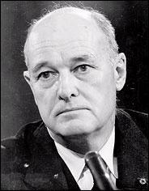
George F. Keenan
A member of the State Department, he felt that the best way to keep Communism out of Europe was to confront the Russians wherever they tried to spread their power.

Slide 55

Korean War, 1950
On June 25, 1950, the Communist North invaded the Democratic South. The United Nations created an international army, lead by the U.S. to fight for the South and China joined the war on the side of North Korea. This was the first time the United Nations had intervened militarily.

Slide 56

38th Parallel Line
The dividing line between North and South Korea.

Slide 57

Limited War
A war fought to achieve only specific goals. President Truman wanted the Korean War to be a “limited war”. One in which the fighting would be contained to the Korean peninsula and the military would only use conventional weapons.

Slide 58

Truman/MacArthur
During the Korean War Truman wanted to fight a limited war, but MacArthur wanted to expand the war into China and use nuclear weapons. Truman removed MacArthur from his command on grounds of insubordination.

Slide 59

Brinkmanship
Foreign policy plan under President Eisenhower in the 1950’s. It was the practice of threatening an enemy with massive military retaliation for any aggression.

Slide 60


The Rosenbergs
Married couple Julius & Ethel Rosenberg were both accused by the U.S. government of selling the Soviet’s the information needed to build and explode an atomic bomb. They were found guilty of espionage and put to death by the electric chair.

Slide 61

Alger Hiss
A former State Department official that was accused of spying for the Soviets. He was convicted of perjury and went to jail.

Slide 62

Middle East
Region extending from Sudan, Egypt, and Turkey in the west to Iran in the east and includes the nations of Iraq, Israel, Jordan, Syria, and Saudi Arabia. Site of the Suez Canal Crisis in the 1950’s.

Slide 63

Sputnik, 1957
The first artificial satellite sent into space, launched by the Soviets.

Slide 64

Space Race
The competition between the United States and the Soviet Union to develop the technology needed to successfully land on the moon.

Slide 65

House Un-American Activities Committee (HUAC)
The House Committee on Un-American Activities- a congressional committee that investigated Communist influence inside and outside the U.S. government in the years following World War II.

Slide 66

McCarthyism, 1950-1953
Senator who began sensational campaign by asserting that the U.S. State Department had been infiltrated by Communists. He accused the Army of covering up foreign espionage. The Army-McCarthy Hearings made McCarthy look so foolish that further investigations were halted.

Slide 67
Domino Theory, 1957
It stated that if one country fell to Communism, it would undermine another and that one would fall, producing a domino effect.

Slide 68

Khruschev
He was the premier (dictator) of the U.S.S.R. during the 1950’s and 1960’s. In 1960 he accused the U.S. of spying on the U.S.S.R. when they shot down a U.S. U-2 spy plane over Soviet airspace.

Slide 69

U-2 Incident
The downing of a U.S. U-2 spy plane over the Soviet Union in 1960. At first the U.S. denied it was a spy plane. The pilot by Francis Gary Powers was captured by the Soviets and sentenced to 10 years in prison.

Slide 70

The 1950’s
DOMESTIC Policy
U.S. History

Slide 71

GI Bill of Rights
A name given to the Servicemen’s Readjustment Act, a 1944 law that provided financial and educational benefits for World War II veterans.

Slide 72

Post W.W.II Economic Boom
Following W.W.II the U.S. economy took a dip as the U.S. government canceled war contracts and factories converted back to peacetime production. But soon made a remarkable recovery as people spent money on new homes, cars, & appliances.

Slide 73

Baby Boom 1945-1964
The sharp increase in the U.S. birthrate following World War II. The baby boom lasted from 1945 to 1964.

Slide 74

Suburbs
A residential town or community near a city. In the 1950’s one of the first postwar developments was built by William Levitt on New York’s Long Island. Called Levittown it consisted of hundreds of standardized homes. With the help of Interstate highways these new homes led to urban sprawl.

Slide 75

Interstate Highway System
1956 law signed by President Dwight Eisenhower that authorized the spending of $32 billion to build 41,000 miles of 4-lane divided highways across the U.S.

Slide 76

Housewife & Mother
During the 1950’s housewife and mother was the stereotypical roll of women that was glorified in popular magazines, movies, and on T.V.

Slide 77

Social Conformity
Behavior or attitudinal compliance with recognized social patterns or standards.

Slide 78

Rock-N-Roll
A form of popular music, characterized by heavy rhythms and simple melodies, that developed from gospel and rhythm and blues traditions of African-American during the 1950’s. Artists included Elvis, Little Richard, Chuck Berry, & Bill Haley.

Slide 79

Television
Introduced to the American public in the 1950’s these small boxes with round screens developed at lightning speed to the point that 90% of all U.S. homes owned one by 1960.

Slide 80

The 1960’s foreign & Domestic policy
U.S. History

Slide 81

Flexible Response
A policy, developed during the Kennedy administration, that involved preparing for a variety of military responses to international crises rather than focusing on the use of nuclear weapons.

Slide 82

Bay of Pigs Invasion
In 1961 President Kennedy signed off on a plan in which the CIA trained Cuban exiles living in south Florida for an invasion of a of the island of Cuban. The hope was that Cubans would join them and rise up against the Castro communist government.

Slide 83

Cuban Missile Crisis, 1962
After discovering the Russians were building nuclear missile launch sites in Cuba, the U.S. announced a quarantine of Cuba. After six days of confrontation that almost led to nuclear war, Khrushchev agreed to dismantle the launch sites.

Slide 84

Berlin Wall
The economy of East Germany suffered as many of its residents left for West Berlin. So in 1961 the East German government ordered the construction of a wall to isolate West Berlin from communist controlled East Berlin.

Slide 85

Limited Nuclear Test Ban Treaty
The 1963 treaty in which the U.S, the Soviet Union, and over 100 other nations agreed to ban nuclear-weapons test in the atmosphere, outer space, & underwater. Test could continue underground. China and France refused to sign the treaty.

Slide 86


Peace Corp
An agency established under the Kennedy administration in 1961 to provide volunteer assistance to developing nations in Asia, Africa, and Latin America.

Slide 87

War on Poverty
President Lyndon Johnson’s programs aimed at aiding the country’s poor through education, job training, proper health care, and nutrition.

Slide 88

LBJ’s Great Society
President Johnson’s plan that was passed by Congress between 1964 & 1967 included programs to reduce poverty and racial injustice and to promote a better quality of life in the U.S. Examples: Project Headstart and Medicare.

Slide 89

Vietnam War 1964-1973
Part of the U.S. containment policy to stop the spread of communism into southeastern Asia. Vietnam was a French colony called French-Indochina until the 1950’s. In 1964 the U.S. entered the conflict to stop the communist north.

Slide 90

Gulf of Tonkin Resolution, 1964
After a U.S. Navy ship reportedly was fired on, Congress passed this resolution which gave the president power to send troops to Vietnam to protect against further North Vietnamese aggression.

Slide 91

Tet Offensive
A massive surprise attack during the Vietnam War by the Vietcong on South Vietnamese towns and cities in January 1968.

Slide 92

Nixon Doctrine
At a press conference held on 25 July 1969, President Richard Nixon outlined this foreign policy plan that stated that the U.S. would continue to provide military aid & supplies, but we expected all of our allies to assume responsibility for providing for their own military defense.

Slide 93

Vietnamization
President Nixon’s strategy for ending U.S. involvement in the Vietnam War, involving the gradual withdrawal of U.S. troops and their replacement with South Vietnamese forces.

Slide 94

Anti-War Movement
Movement that started on college campuses across the U.S. in the 1960’s to protest the war in Vietnam. It was made up of college students, professors, housewives, returning war veterans, ministers, nuns, and even members of the U.S. government.

Slide 95

Fall of Saigon
In 1973 a cease-fire collapsed in Vietnam. The communists started a full scale invasion of the South. Without U.S. forces in place the South was weak. The North rolled into the capital city of Saigon and it fell.

Slide 96

Civil rights and other social movements
U.S. History

Slide 97

Plessy Vs. Ferguson
An 1896 case out of Louisiana in which the U.S. Supreme Court ruled that separation of the races in public accommodations was legal, thus establishing the “Separate but Equal” doctrine.

Slide 98

14th Amendment
An amendment to the U.S. Constitution, adopted in 1868, that made all persons born or naturalized in the United States- including former slaves- citizen of the country and granted them all equal protection under the law.

Slide 99

Separate but Equal
This clause in the law in 1896 allowed states to maintain segregated facilities for blacks and whites so long as they provided equal services.

Slide 100

Brown v. Board of Education, 1954
The Supreme Court overruled Plessy v. Ferguson, declared that racially segregated facilities are inherently unequal and ordered all public schools desegregated.

Slide 101

NAACP
The National Association for the Advancement of Colored People- an organization founded in 1909 to promote full racial equality.

Slide 102

Thurgood Marshall
NAACP lawyer in the Brown v. BOE case who argued to the U.S. Supreme Court that segregated public schools were unconstitutional. He became the first African-American appointed to the U.S. Supreme Court.

Slide 103

Rosa Parks
A seamstress and NAACP officer, she was arrested in Montgomery, Alabama for refusing to give up her bus seat to a white man on December 1, 1955. This led to a major boycott of that cities bus system.

Slide 104

Montgomery Bus Boycott
1955-1956 protest by African-Americans in Montgomery, Alabama against racial segregation in the cities bus system.

Slide 105

Martin Luther King, Jr.
The leader of the Civil Rights Movement and President of the Southern Christian Leadership Conference, promoted non-violent protest.

Slide 106

Civil Disobedience
The refusal to obey those laws which are seen as unjust in an effort to bring about change in government policy. Dr. King made this the cornerstone of the American Civil Rights Movement.

Slide 107

Little Rock Central High School
In September 1957 this Arkansas public school enrolled nine African-American students in an attempt to gradually desegregate the public school system.

Slide 108


Sit-Ins
A form of demonstration used by African- Americans to protest discrimination, in which the protesters would sit down at a segregated business like a lunch counter and refuse to leave until they were severed.

Slide 109

Freedom Riders
One of the civil rights activists who rode buses through the South in the early 1960’s to challenge segregation. They were attacked several times in the State of Alabama.

Slide 110

James Meredith & Ole Miss
In September 1962, African-American James Meredith an Air Force veteran won a federal court case allowing him to enroll in the all-white University of Mississippi. As a result a riot broke out on campus. It took 500 soldiers, 200 arrest, and 15 hours to stop the rioters. Two people were killed.

Slide 111

Birmingham 1963
In 1963 Alabama’s largest city was known for its strict enforcement of Jim Crow laws. Dr. King and civil rights demonstrators took on the city of Birmingham and its police department. They even used children in the protest. The police fought back with attack dogs and high powered fire department water hoses.

Slide 112

March on Washington 1963
To persuade Congress to pass a civil rights bill, a major march was held in Washington, D.C. Over 250,000 people showed up on the Mall. Dr. King delivered his famous “I Have a Dream” speech.

Slide 113

Mississippi Freedom Summer 1964
A 1964 project to register African-American voters in Mississippi. A state in which 90% of it African American population were kept from being able to vote. Many of the people that took part in this project were northern college students.

Slide 114

Civil Rights Act 1964
A law that banned discrimination on the basis of race, sex, national origin, or religion in public places and most workplaces.

Slide 115

Bloody Sunday
On 7 March 1965, about 600 protesters set out to march some 50-miles from Selma, Alabama to Montgomery, Alabama. The protesters, many of which were African-American were attacked by White Alabama State Troopers who used whips, clubs, and tear gas to break-up the protest group. The purpose of the march as to get Congress to pass a voting rights act.

Slide 116

Voting Rights Act 1965
A law that made it easier for African Americans to register to vote by eliminating discriminatory literacy tests and authorizing federal examiners to enroll voters denied at the local level.

Slide 117

Malcolm X
Malcolm X expressed the feelings of many African American activists who had grown impatient with King’s nonviolent methods. Malcolm X preached a message of self-reliance and self-determination.

Slide 118

The book: Feminine Mystique by Betty Friedan, 1963
Depicted how difficult a woman's life is because she doesn't think about herself, only her family. It said that middle-class society stifled women and didn't let them use their talents. Attacked the "cult of domesticity."

Slide 119

Women’s Movement
Movement that started in the U.S. in the 1800’s that sought greater rights and opportunities for women. In 1966 this movement founded a group called NOW. This group worked in creating new opportunities for women in the fields of education, employment, and politics.

Slide 120

Equal Rights Amendment -ERA
In 1972 Congress passed the ERA. The amendment needed ratification by 38 of 50 states to become part of the U.S. Constitution. It would have guaranteed that both men and women would enjoy the same rights and protections under the law. By June 1982 the ERA was dead, 3 states short of passage.

Slide 121

Cesar Chavez
Non-violent leader of the United Farm Workers from 1963-1970. Organized laborers in California and in the Southwest to strike against fruit and vegetable growers. Unionized Mexican-American farm workers.

Slide 122

United Farm Workers-UFW
A labor union formed in 1966 to seek higher wages and better working conditions for Mexican-American farm workers in California.

Slide 123

Student’s Rights Movement
In the 1960’s college students across the nation protested dress codes, curfews, dormitory regulations and mandatory ROTC programs on college campuses. These protest led to the Anti-War Movement protest.

Slide 124

Counterculture Movement
The culture of the young people who rejected mainstream American society in the 1960’s, seeking to create an alternative society based on peace, love, and individual freedom.

Slide 125

Hippies
These were members of the Counterculture Movement of the 1960’s who dropped out of mainstream society by embracing peace, love, and drugs.

Slide 126

Black Power Movement
A slogan-first used in the 1940’s and revived by Stokely Carmichael in the 1960’s- that encouraged African-American pride and political and social leadership.

Slide 127

Black Panthers
A militant African-American political organization formed in 1966 by Huey Newton and Bobby Seale to fight police brutality and to provide services in low income areas.

Slide 128

American Indian Movement
A frequently militant organization that was formed in 1968 to work for Native American rights like:
the return of lost lands
the return of lost hunting, fishing and timber rights
the protection of burial grounds

Slide 129

The 1970’s
U.S. History

Slide 130

Richard Nixon
He was the president of the U.S. from 1969 to 1974 when he resigned the office in the wake of the Watergate scandal in 1974.

Slide 131

Henry Kissinger
He was the architect of President Nixon’s foreign policy plan called Détente as served as Nixon’s Nation Security Advisor before he was promoted to Secretary of State.

Slide 132

Détente
A lessening of tensions between U.S. and Soviet Union and China. Besides disarming missiles to insure a lasting peace between superpowers, Nixon pressed for trade relations and a limited military budget.

Slide 133

SALT I
A five year agreement between the U.S. and the Soviet Union, signed in 1972, that limited the nation’s number of intercontinental ballistic missiles and submarine launched missiles.

Slide 134

Title IX, 1972
"No person in the United States shall, on the basis of sex, be excluded from participation in, be denied the benefits of, or be subjected to discrimination under any education program or activity receiving Federal financial assistance."

Slide 135

War Powers Act, 1973
Gave any president the power to go to war under certain circumstances, but required that he could only do so for 90 days before being required to officially bring the matter before Congress.

Slide 136

Arab-Israeli War 1973
A 1973 conflict in which the nations of Egypt and Syria attacked Israel on its most holy Jewish holiday in an attempt to regain territories lost to Israel in the 1967 Six-Day War.

Slide 137

Energy Crisis
This was a result of an oil embargo that was imposed on the U.S. by OPEC thus hurting U.S. businesses, industries, homeowners, and motorist.

Slide 138

Rachel Carson
A marine biologist who in 1962 wrote a book called “Silent Spring” in which she warned against the growing use of pesticides-chemicals used to kill insects, weeds, and rodents claiming that they also poisoned the food and killed fish & birds.

Slide 139

EPA
An agency established in 1970 to enforce pollution standards, to conduct research, and to assist state and local governments in pollution control.

Slide 140

Earth Day
Started in 1970. A day set aside for environmental education, celebrated annually on April 22.

Slide 141

Roe Vs. Wade
1973 U.S. Supreme Court case out of Texas in which the court decided that states could regulate abortions only in certain circumstances but otherwise a women’s right to an abortion was protected by her right to privacy.

Slide 142

Imperial Presidency
A book by historian Arthur SchlesingerJr. that argued that by the time Nixon became president, the executive branch had taken on an air of supreme authority.

Slide 143

Watergate Scandal, 1972-1974
In 1972, five men were arrested for breaking into the Democratic National Committee's executive quarters in the Watergate Hotel. Nixon admitted to complicity in the burglary. In 1974, as Nixon's impeachment began, he resigned.

Slide 144

Executive Privilege
Principle that the President has the right to keep certain communications between himself and other members of the executive branch private. Nixon claimed that he had this right during Watergate when it came to his tapes.

Slide 145

Helsinki Accords
Agreement made in 1975 when Gerald Ford was President of the U.S. The U.S., Canada, and several European nations, including the Soviet Union agreed to support human rights.

Slide 146

Camp David Accords, 1978
Peace talks between Egypt and Israel mediated by President Carter.

Slide 147

Nuclear Energy
Energy that exists inside the nucleus of an atom is used as a sources of power in the U.S. This type of energy serves as an alternative to foreign oil or coal.

Slide 148

Three Mile Island
Nuclear power plant near Harrisburg, Pennsylvania that on 28 March 1979 malfunctioned when its reactor overheated after its cooling system failed.

Slide 149

Iran Hostage Crisis
In November 1979, armed students seized the U.S. embassy in Tehran, Iran and took 52 American’s captive for 444 days demanding that the U.S. return their exiled king (Shah) to stand trail for crimes against his people.

Slide 150
Affirmative Action
Policy that gives special consideration to women and minorities to make up for past discrimination.

Slide 151

Regents of the University of California v. Bakke, 1978
Barred colleges from admitting students solely on the basis of race, but allowed them to include race along with other considerations when deciding which students to admit.

Slide 152

The 1980’s, 1990’s, & 2000’s
U.S. History

Slide 153

North American Free Trade Agreement (NAFTA), 1992
The North American Free Trade Area is the trade bloc created by the North American Free Trade Agreement (NAFTA), whose members are Canada, Mexico and the United States.

Slide 154

Election of 2000
In the presidential election of 2000 Republican George W. Bush was elected over Democrat Al Gore in one of the closest and most controversial presidential elections in the history of the United States.

Slide 155

September 11, 2001
The September 11, 2001 attacks consisted of a series of coordinated terrorist suicide attacks by Islamic extremists on the United States on September 11, 2001.

Slide 156

No Child Left Behind, 2002
President Bush signed the No Child Left Behind Act. The law helps schools improve by focusing on accountability for results, freedom for states and communities, proven education methods, and choices for parents.

