Slide 1
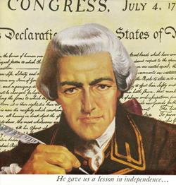
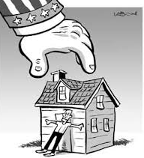
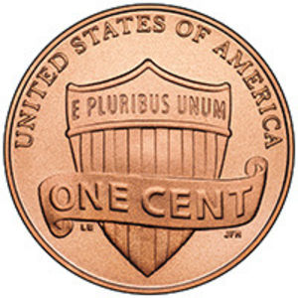
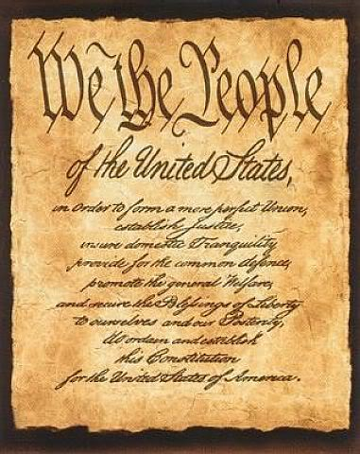
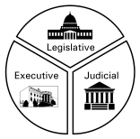
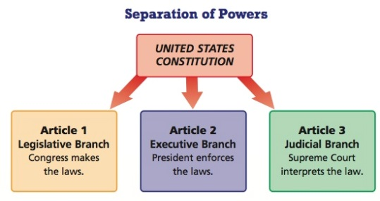
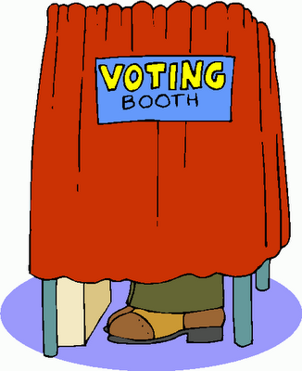
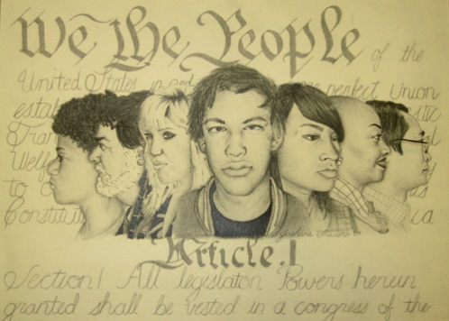
No Taxation Without Representation
Foundations:
Background to
American History
STAAR Review 1

Slide 2
Causes of American Revolution
During the mid-1700s the British and French fought a war for control of North America.
The British won the “French and Indian War”, but it was at a high cost.
To help repay this debt, the British government placed taxes on the colonists, including the Stamp Act, the Tea Act, and the Townsend Act.
The colonists were not consulted by the British and they felt this violated their rights as English citizens.

Slide 3
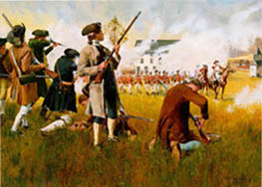
Causes of American Revolution
To show their displeasure with these ‘Acts’ the colonists came up with the slogan of :
No Taxation Without Representation
By 1773 the colonists had begun protesting, they boycotted (refused to buy) British goods, some dressed as Indians and dumped tea off of a British ship.
By 1775, the colonists and British soldiers exchanged shots at Lexington & Concord, the first battle of the American Revolution!

Slide 4
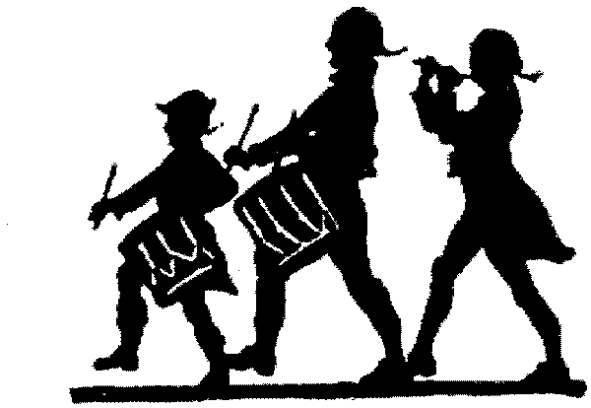
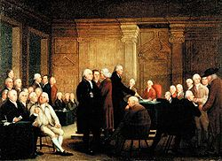
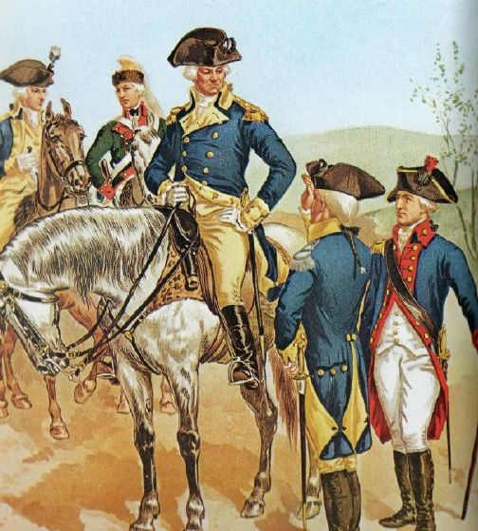
The American Revolution
The ‘Second Continental Congress’ selected George Washington as the Commander in Chief of the new Continental Army.
It would be Washington’s skill and leadership that would lead the colonists to independence.

Slide 5
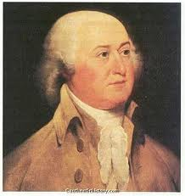
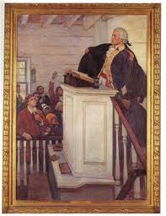
Leaders of the Revolution
John Trumball Jr. was the governor of Connecticut during the war.
He refused to join the British, instead he supplied Washington’s troops with food, clothing, and weapons.
John Peter Muhlenberg was a minister who used his role in the church to help recruit men for the colonial army.
His group was called the Black Regiment, after the black robes he wore.

Slide 6
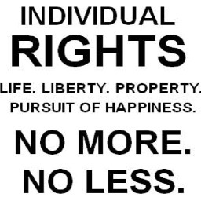
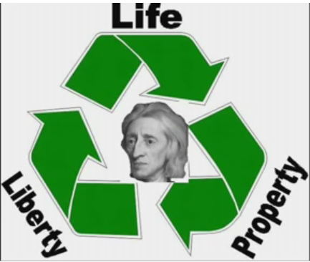
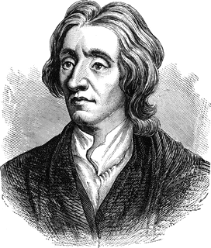
Influences on the Declaration
John Locke influenced the writing of the Declaration of Independence with his idea of ‘unalienable rights’.
Locke believed that the government was supposed to protect an individuals unalienable or natural rights.
Locke stated these rights were life, liberty, and pursuit of happiness that cannot be taken from you without due process.
Jefferson stole my idea

Slide 7
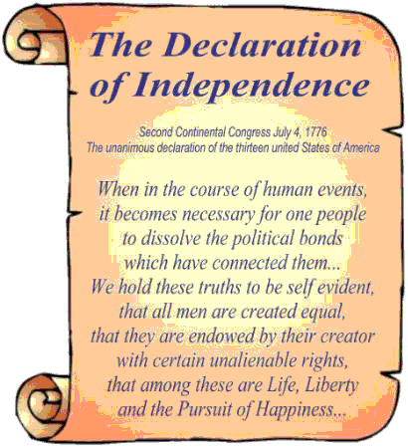
The Declaration of Independence
In 1776 the ‘2nd Continental Congress’ began discussing the idea of declaring independence from England.
Thomas Jefferson was appointed to head a committee to draft a statement of independence from England.
July 4, 1776, the final draft was approved:
It explained why we should be free.
It listed the grievances (complaints) we had with King George III and England’s Parliament.
It declared our independence!

Slide 8
Excerpts from; The Declaration of Independence
When in the Course of human events, it becomes necessary for one people to dissolve the political bands which have connected them with another,
Sometimes it’s just not working and you have to roll with someone else.

Slide 9
Excerpts from; The Declaration of Independence
a decent respect to the opinions of mankind requires that they should declare the causes which impel them to the separation.
The respectful thing to do to tell your leaders why you are tired of their crap!

Slide 10
Excerpts from; The Declaration of Independence
We hold these truths to be self-evident, that all men are created equal,
All men, except for women, slaves, Native Americans, or other minorities

Slide 11
Excerpts from; The Declaration of Independence
that they are endowed by their Creator with certain Unalienable Rights, that among these are Life, Liberty and the pursuit of Happiness.
I tell you it was my idea
These rights cannot be taken without due process, meaning the government must follow certain steps before taking your life, liberty, or property.
The king had not been following these legal steps.

Slide 12
Excerpts from; The Declaration of Independence
That to secure these rights, Governments are instituted among Men, deriving their just powers from the consent of the governed,
In order to protect these unalienable rights for the people, governments are created by the people,
and these people agree or consent
to follow the laws created.

Slide 13
Excerpts from; The Declaration of Independence
That whenever any Form of Government becomes destructive of these ends, it is the Right of the People to alter or to abolish it, and to institute new Government,
If the government fails to protect these unalienable rights and is not serving the people, then the peeps should revolt and create a new government that does !

Slide 14
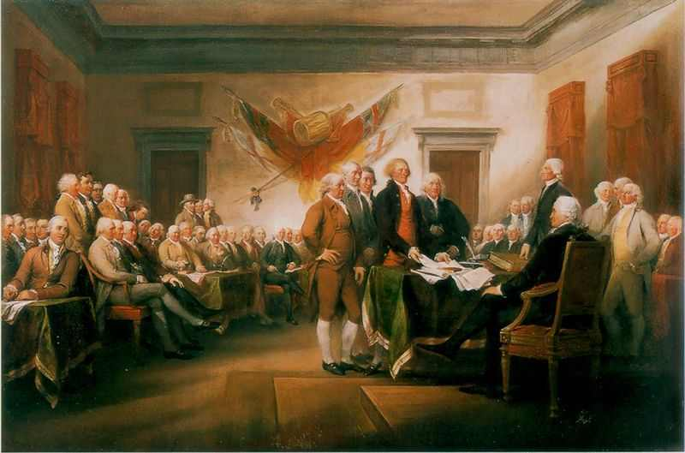
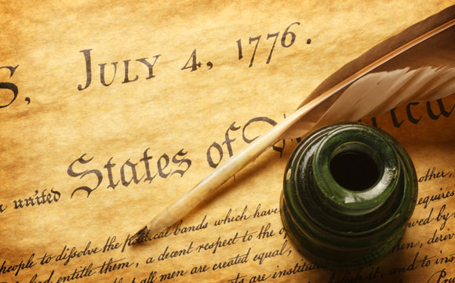
Signers of the Declaration
56 men met in Philadelphia, Pennsylvania to sign the Declaration of Independence on July 4, 1776.
These men acted courageously, because the act of signing the Declaration was treason and was punishable by hanging.

Slide 15
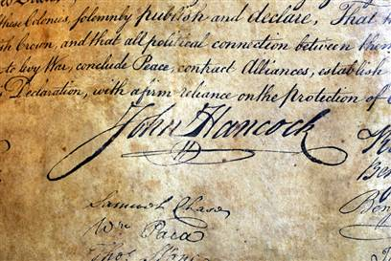
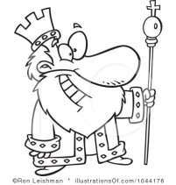
Signers of the Declaration
John Hancock made his signature so large that even the King of England could read it without his glasses.
Hancock was the President of the Congress and the first version of the Declaration only carried Hancock’s signature when it was sent to the 13 Colonies.
Hancock’s name became 2nd only to Washington's as a symbol of freedom and independence.
Man that guy writes big

Slide 16
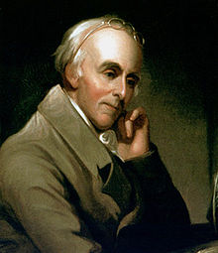
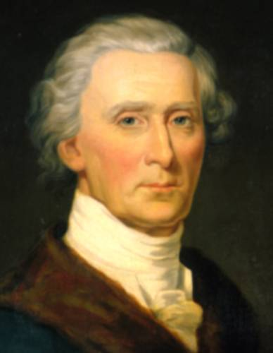
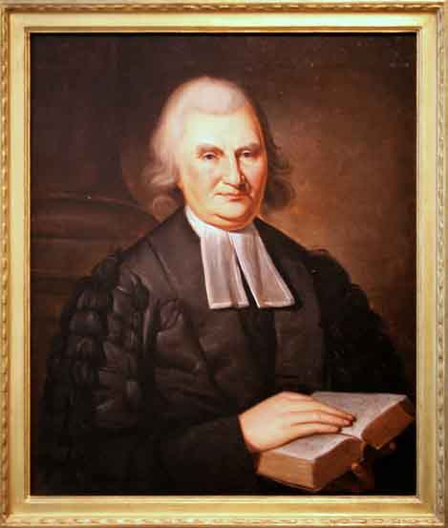
Signers of the Declaration
Dr. Benjamin Rush is sometimes known as the ‘Father of American Medicine’. He supported educating women and helped fund an African-American church.
Charles Carroll a wealthy businessman, he helped support Revolution with his own money. He also supported Catholics, that freedom of religion thing.
Dr. John Witherspoon a church minister supported independence, he was quoted as saying ;
“America was not only ripe for independence,
it was in danger of rotting for want of it.”

Slide 17
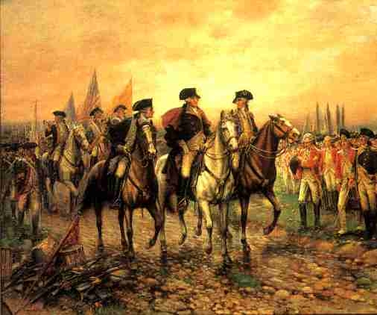
Americans Win the Revolution
After winning the first battle at Lexington & Concord (1775), the American colonists lost many battles.
Things looked grim until a surprise victory at Saratoga (1777), which brought the French into the war on our side.
Finally at Yorktown (1783), the Continental Army forced the British to surrender and the war was over.
In 1783, we became the :
United States of America

Slide 18
The Constitution
The Declaration of Independence (1776) stated the goals of the Americans.
It promised a system of government that promoted liberty, equality, and protection of individual rights, based on the desires of the people.
It would be the U.S. Constitution that would turn these goals into a concrete system of government.

Slide 19
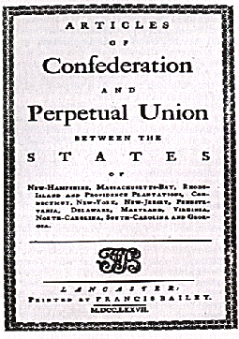
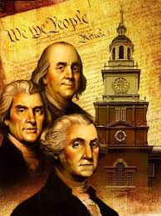
The Constitution
The Constitution wasn’t the first government the USA established.
Originally the colonies were ruled by a ‘loose’ agreement called the Articles of Confederation.
The Articles of Confederation was an experiment in government that failed, it gave too much power to the state governments and not enough to the federal government.
Notes:
io

Slide 20
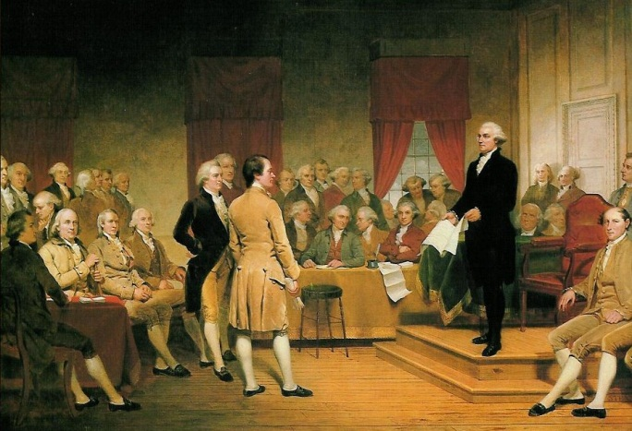
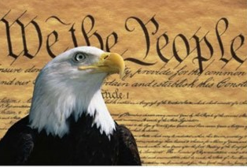
The Constitution
In 1787 the Continental Congress wrote the U.S. Constitution, this document established the basic structure of our government.
It created a government in which the people hold the power, they elect their own representatives, as shown in the first three words.
We the People…
Remember, before the Revolution, the American colonists were not represented in the government.

Slide 21
The Constitution
The founding forefathers wanted to create a government that was strong enough to defend our nation’s interests and to promote our general welfare.
They gave national (federal) government many powers and they made the federal law supreme over any state law.
That’s why the Constitution is often called the -
Supreme Law of the Land

Slide 22
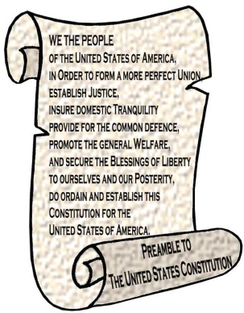
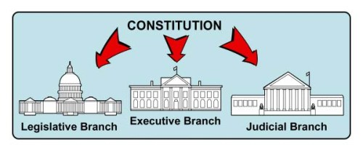
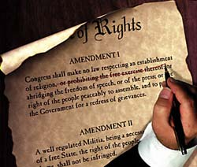
The Constitution
The Constitution is divided into 3 parts.
The Preamble
Introduction explains goals of Constitution.
The part we all know because it starts with “We the People…”
The Articles
Seven Articles establish the different parts of government and the power and responsibilities of each branch.
The Amendments
The changes that have been made
First Ten Amendments aka ‘Bill of Rights’
17 Amendments have been added over last 200+ years for a total of 27 Amendments

Slide 23
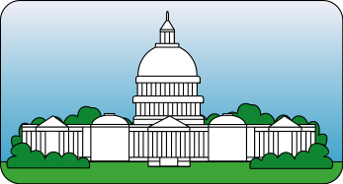
Legislative Branch
The Constitution set up our government with 3 branches.
Legislative – Executive - Judicial
Legislative - the Congress was established under Article I
Congressmen are elected by the people of the USA
Senate
2 Senators for each state,
100 Senators total
House of Representatives
based on a states population, bigger states = more ‘reps,
435 Representatives total
Create our laws
Raise or lower our taxes
Declare war

Slide 24
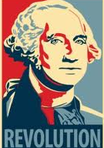
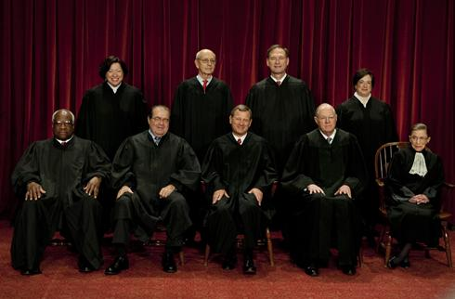
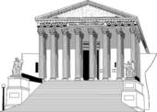
Executive & Judicial Branches
Executive – the President was established under Article II
Commander of the Military
Signs bills into law
Appoints Supreme Court judges
Judicial – Supreme Court was established under Article III
“Marbury v Madison” gave Supreme Court the power of Judicial Review, to determine if a law follows the Constitution.
Lower courts across the USA
9 Justices on the Court

Slide 25
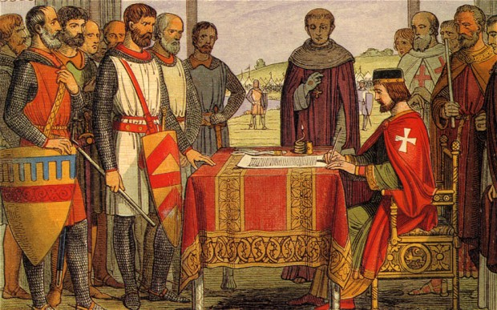
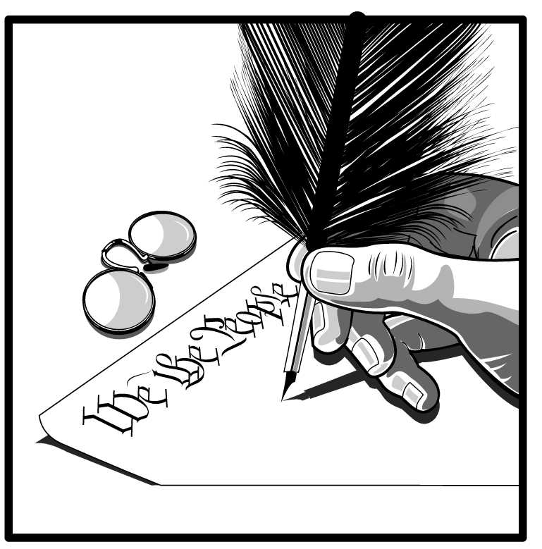
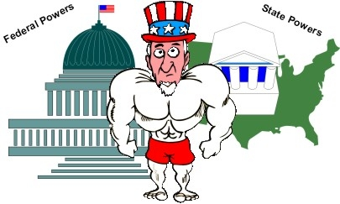
Principles of The Constitution
Limited Government – powers are limited by the Constitution. King John signed Magna Carta in 1215 limiting the powers of the ruler.
Popular Sovereignty – the people hold the power and give the government its power. We consent to be governed.
Federalism – power is divided between the national government and the states. Some are shared, some only for national, some only for the states.

Slide 26
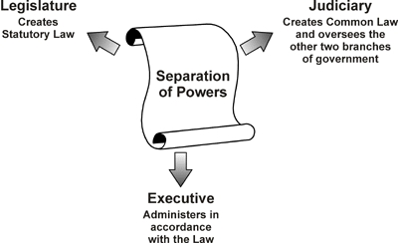
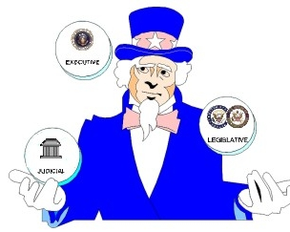
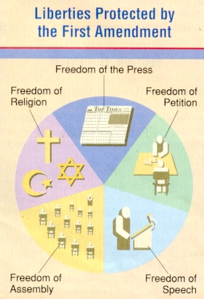
Principles of The Constitution
Separation of Powers – federal government is divided into three separate branches.
Checks and Balances – prevents any one branch from becoming too powerful, each branch can stop or ‘check’ the other two.
Amendments – Constitution allows for changes or ‘amendments’ to adapt to changing times and events.
The 1st 10 are the Bill of Rights.
There has been 27 all totaled

Slide 27
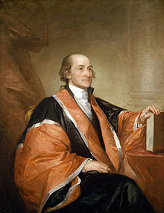
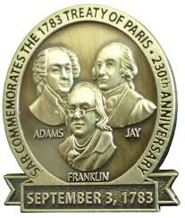
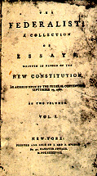
John Jay
John Jay was a member of the Continental Congress that created the Constitution.
Jay helped negotiate the ‘Treaty of Paris’ ending the American Revolution.
One of the authors of the ‘Federalist Papers’ used to convince Americans to support the Constitution.
Pres. G. Washington appointed John Jay as the 1st Chief Justice of the Supreme Court.
Jay later served a governor of New York where he worked to fix prison problems and to abolish slavery

Slide 28
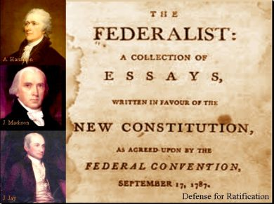
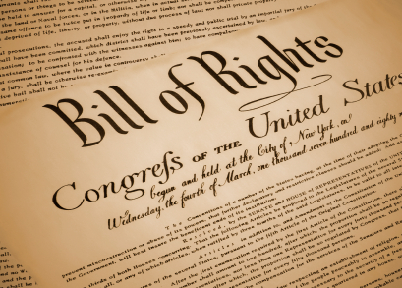
The Bill of Rights
When the Constitution was first created in 1787, not everyone thought it did enough to protect our individual rights.
The Federalist Papers helped convince many that the Constitution would work.
To make sure of everyone’s support, when the Continental Congress met again in 1789 they added ten amendments to aid in protecting our individual liberties and freedoms.
These 1st Ten Amendments became known as the Bill of Rights.

Slide 29
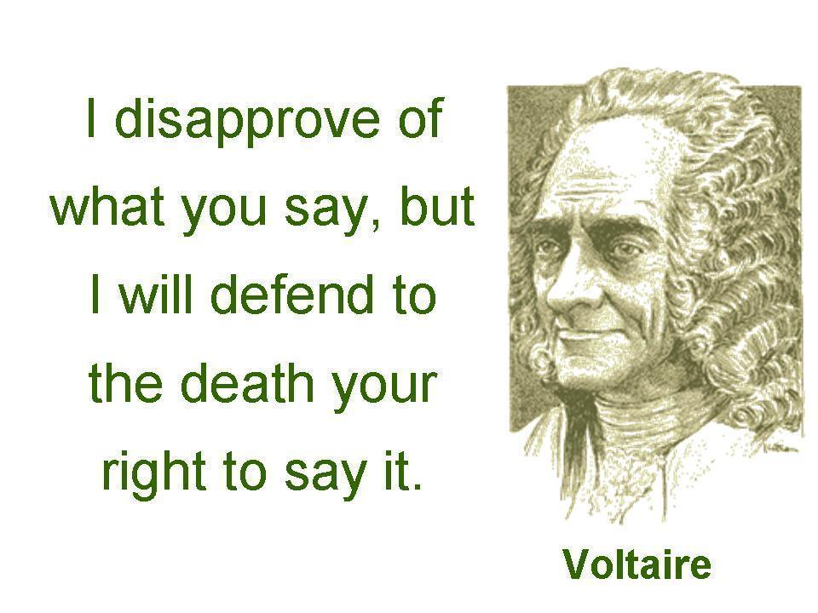
The Bill of Rights
1st Amendment
The First Amendment is actually 5 different amendments.
Freedom of Religion
many who came to America came for religious freedoms, they didn’t want to be told by their government what they had to believe in.
Freedom of Speech
Protects our freedom to say or write most things.
You cannot be jailed for criticizing your government, as was formerly done.
BUT, you cannot create a ‘clear and present danger’ with your speech that might harm others, such as yelling fire in a crowded place.

Slide 30
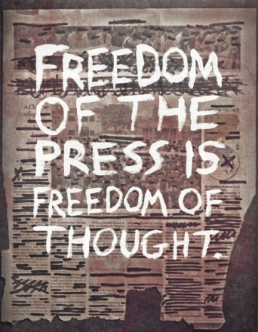
The Bill of Rights
1st Amendment
Freedom of the Press
Allows newspapers, radio, television, or the internet to write or publish what they want to without fear of punishment.
People need a free press in a democracy to be informed voters!
Freedom of Assembly
During the Revolution it was illegal to gather in groups of more than three, we now have the right to peaceful assembly.
Freedom to Petition
You have the right to write to government officials asking them to change a law or create a law without fear of punishment.

Slide 31
The Bill of Rights
2nd & 3rd Amendments
2nd - Right to Bear Arms
People have a right to ‘bear arms’.
‘a well regulated military is necessary to security of a free state’.
What about automatic weapons????
3rd - Prohibits Quartering of Soldiers
During Revolution the King placed troops in homes of civilians at their expense.
This prevents the government from placing soldiers in a civilian’s home.

Slide 32
The Bill of Rights
4th Amendment
The 4th, 5th, 6th and 8th Amendments prohibits government officials from taking away a person’s life, liberty or property without following certain fair and reasonable procedures.
4th – No Unreasonable Searches
Colonists were smuggling products so as not to pay the British taxes,
British government officials would randomly search a colonists property looking for smuggled goods.
Now a judge has to sign a ‘search warrant’ before your property can be legally searched

Slide 33
The Bill of Rights
5th Amendment
5th - A person cannot be deprived of life, liberty, or property without “due process of law”. Certain legal procedures must be carried out before a person can be punished.
Eminent Domain gives government the right to take private property for public use, but they must give you fair compensation (payment) for the property. Like taking your home to build a road.
Double Jeopardy cannot be tried for the same crime twice. Like OJ Simpson.
Grand Jury is required to issue an indictment before you can be tried for a serious crime.
Self-Incrimination cannot be forced to testify against yourself. Supreme Court ruling of Miranda v. Arizona says you must be informed of your rights or what you say cannot be used.

Slide 34
The Bill of Rights
6th & 8th Amendments
6th Fair and Impartial Trial
Must be told of charges against them
Right to a trial by jury
Right to be represented by a lawyer
8th No Cruel or Unusual Punishment
No high bail
Punishment must fit the crime
No cruel punishments
No torture

Slide 35
The Bill of Rights
9th & 10th Amendments
9th & 10th attempt to limit the powers of the government
9th Amendment
Just because the Constitution doesn’t list a right doesn’t mean we don’t have it.
the people have all rights not specifically given to the government.
10th Amendment
The federal government has only those powers specifically given to it in the Constitution.
All other powers are reserved for the states or the people!

Slide 36
What Are Americans ?
We have found out that colonists fought the American Revolution to gain their unalienable rights the King had been taking from them.
We know the Declaration of Independence explained our issues with England and expressed our desire for freedom.
We created the Constitution to limit the powers of a government and to protect our individual freedoms.
We discovered how Americans came to be a people….
But, What are Americans ?

Slide 37
What Are Americans ?
As the American Revolution came to an end and a new United States began to grow, some people began to notice that America was much different than Europe.
In Europe there were still hereditary social classes (born rich), with little chance of advancement for those born poor.
Land in Europe was owned by a few wealthy families and there was very little land available for people to buy.
Rich
Poor

Slide 38
What Are Americans ?
In Germany there were people with a common German ancestry, in France they were French, in England they were English, and so no and so on…
But, in America a new society developed
Opportunities were there for those who chose to work for them.
Americans were everything from everywhere, a huge mixture of nationalities that had never before been seen.

Slide 39
What Are Americans ?
Hector St. John de Crevecoeur was a French immigrant who came to America in the mid 1700s.
St. John de Crevecoeur wrote a book Letters to an American Farmer describing the new American society.
He was impressed by the melting pot (mixing of people), the natural resources available, the absence of Kings and nobles, and the willingness of the Americans to work hard to improve their lives.

Slide 40
What Are Americans ?
Alexis de Tocqueville was sent to America by the French government to study the American prison system.
Tocqueville wrote Democracy in America in which he tried to identify how the new Americans were different from the European society they had come from.
Tocqueville observed that the Americans differed because of their social equality and had an overriding concern with money
I know of no country where the love of money has taken a stronger hold on the affections of men
But I do know Mr. Dumalet

Slide 41
Tocqueville’s Take On the USA
Tocqueville had 5 values he found important to America’s success as a constitutional republic
1
King
Egalitarianism refers to equality in society.
Europe had been built around distinct hereditary classes which separated the nobles from the middle class and the poor.
In America everyone was socially equal, except slaves and Native Americans.
The availability of land and the ability of anyone owning it in America was unheard of in Europe.
Nobles
Middle Class
Poor
Europe’s Social Classes
King
America’s Social Classes

Slide 42
Tocqueville’s Take On the USA
2
Tocqueville had 5 values he found important to America’s success as a constitutional republic
Populism refers to the participation of the common people in government.
Tocqueville found that in American society everyone had the same right to take part in their government.
3
Liberty refers to the protection from a tyrannical (all powerful) government.
Tocqueville found Americans devoted to ‘rule of law’ and the ‘federal system’ preventing an over-powerful government.

Slide 43
Tocqueville’s Take On the USA
4
Tocqueville had 5 values he found important to America’s success as a constitutional republic
Individualism refers to the ability of the people to decide what type of groups or organizations they wished to be part of.
Individuals were free to rise as high in society as their work took them, or as low.
Laissez-Faire refers to the ‘hands off’ approach by the government to our economy.
Tocqueville felt that the individual was the best judge of their own interests, not the government.
5

Slide 44
Individualism

Slide 45
19th Century America (1830s – 1865)
During the 1800s (19th century) the Industrial Revolution introduced the factory system and output of products soared.
Manufacturing, especially in the North, became the primary source of income.
The South also experienced growth in manufacturing, but only at a fraction of the rate.
The West had fewer factories than the North or South.

Slide 46
19th Century America (1830s – 1865)
During the mid-1800s the USA continued its population growth.
The North experienced this growth as people came looking for work in the factories.
While the South remained dependent on slave labor, with 1/3 of the population of the South as slaves.
The West would soon change as the idea of Manifest Destiny would lead settlers into the frontier.

Slide 47
The Civil War (1861-1865)
The rise of industry and the way the government treated the different areas would eventually led to a Civil War.
Southern states believed they had the right to say no to tariffs (taxes on imports) and other laws they disliked.
Southerners were also fearful that the North would abolish slavery, something they depended on to produce their #1 crop of cotton.
As the South became more dependent on cotton, they also became more dependent on slave labor.

Slide 48
The Civil War (1861-1865)

Slide 49
The Civil War (1861-1865)
Timeline of Civil War –
1861 the war starts as South attacks North at Ft. Sumter, SC
1863 Emancipation Proclamation issued by Lincoln freeing slaves in Confederate states.
1863 Battle of Gettysburg and Lincoln gives Gettysburg Address.
1865 South surrender to North at Appomattox Courthouse in VA.
1865 Lincoln assassinated 5 days after Civil War ends

Slide 50
The Civil War (1861-1865)
The Confederacy
In 1861, the South would secede and declare themselves the Confederate States of America, aka The Confederacy.
The Confederacy would start the war with an attack on a Union fort called Ft. Sumter in South Carolina.
The South elected Jefferson Davis as their President, but the real leader of the Confederacy was Gen. Robert E. Lee.

Slide 51
The Civil War (1861-1865)
The Union
Of the people, by the people, for the people
The Northern states, led by Abraham Lincoln, had the advantage of greater resources and a larger population.
At the beginning of the war. Lincoln’s plan was to preserve or keep the Union united as 1 nation.
Later, Lincoln would issue the Emancipation Proclamation, which freed the slaves in the rebelling Confederate states.
13th Amendment would later abolish slavery

Slide 52
The Civil War (1861-1865)
Battle of Gettysburg (1863)
Bloodiest battle ever on USA’s soil, with 50,000 casualties in 3 days that ended the South’s chances of victory.
Gettysburg Address (1863)
Lincoln’s speech to honor the dead, taking just 2 minutes it became most famous speech in American history.
Supported idea of equality as stated in Declaration of Independence.
Explained the Civil War was struggle to preserve the Union (the USA)
Claimed a new birth of freedom to bring equality to all of USA’s citizens.

Slide 54
‘Four score and seven years ago our fathers brought forth on this continent, a new nation, conceived in liberty, and dedicated to the proposition that all men are created equal’
- refers to the Declaration of Independence
‘ --- that this nation, under God, shall have a new birth of freedom – and that government of the people, by the people, for the people, shall not perish from the earth.’
- refers to the
United States
Constitution

Slide 55
^{The} Civil War and Civil Rights
Following the Civil War three Constitutional Amendments were written to protect individual rights and liberties
13th Amendment
Abolished slavery, 9 million people were now free
Many Southerners didn’t agree with this.
14th Amendment
All citizens have ‘due process’ & ‘equal protection’ under the law.
13th had freed the slaves, but many in the South attempted to limit the rights of these newly freed slaves with laws called black codes.
Idea of ‘separate but equal’ was established as a result of this amendment.
15th Amendment
Made it illegal to deny a person suffrage or (right to vote) based on their race.
Gave former male slaves the right to vote.

Slide 56
America After the Civil War
To this ….
From this ….
As a result of the Civil War, the United States government secured it supremacy over the states and the Union remained united as ONE.
“E Pluribus Unum”, which means ‘from many comes one’ shows the idea that America stands together.
“In God We Trust” became our national motto and has been used on our money since 1864.
These words came from our national anthem the Star Spangled Banner.

Slide 57
Manifest Destiny
In 1862 the U.S. Government passed the Homestead Act of 1862.
This law opened settlement of the Great Plains and gave people a chance to become landowners.
Remember Tocqueville’s observation about difference between old school Europe and the new American’s was the ability to acquire land.
So much land is available
The Transcontinental Railroad was completed in 1869, it connected the eastern USA with the west and helped settle the frontier of the West

Slide 58
Declaration of Independence (1776)
Mostly written by Thomas Jefferson during the American Revolution.
Gave reasons why the colonists were demanding independence from Britain.
Listed the grievances of American colonists against the British King.
Argued the purpose of government was to protect citizen’s unalienable rights to life, liberty, and the pursuit of happiness.
Justified the overthrow of a government, if that government abused the people’s rights.

Slide 59
U.S. Constitution (1787)
Replaced the Articles of Confederation.
Established a new government.
Provided for three branches of government:
Executive with a President
Legislative with a two-house Congress
Judiciary with a Supreme Court
Provided a set of principles to ensure the federal government would not be too powerful:
Federalism
Limited government
Checks and Balances
Popular Sovereignty

Slide 60
First Amendment (1791)
Protection of Individual Freedoms
Congress cannot establish a state religion and Congress cannot stop individuals from practicing their own religion.
Congress cannot make laws limiting someone’s freedom of speech.
Congress cannot make laws limiting freedom of the press.
Congress cannot make laws prohibiting people from peacefully assembling.
People have a right to petition their government to correct wrongs.

Slide 61
Bill of Rights (1791)
Other amendments in the Bill of Rights
Protections of Individual Freedoms
Second Amendment: citizen’s have right to bear arms.
Third Amendment : No Quartering of soldiers.
Protections of the Rights of the Accused
Fourth Amendment: No unreasonable searches and seizures by the government.
Fifth Amendment: established a series of ‘due process’ protections.
Sixth Amendment: Fair and impartial trial.
Eight Amendment: No cruel of unusual punishments; no excessive bail or fines.

Slide 62
Alexis de Tocqueville
Frenchman who came to America to study its prison system.
Wrote Democracy in America.
Some historians have identified 5 key characteristics of American democracy that Tocqueville believed set Americans apart from Europeans:
Liberty, Egalitarianism (equality), Individualism, Populism, and Laissez-Faire.

Slide 63
Other Key Individuals
George Washington – served as Commander in Chief of the Continental Army, and as our first President.
Thomas Jefferson – wrote most of the Declaration and later served as 3rd President.
John Hancock – President of the Continental Congress and signed his name in LARGE print on the Constitution.
John Jay – Helped to write the Federalists Papers, was the first Chief Justice of the Supreme Court, and negotiated the Treaty of Paris ending the war.

Slide 64
Other Key Individuals
John Trumbull, Sr. – colonial governor who side with the colonists against British.
John Peter Muhlenberg – minister who recruited soldiers to fight British with his Black Regiment.
Benjamin Rush – Father of American Medicine and signer of the Declaration.
John Witherspoon – signer of the Declaration.
Charles Carroll – signer of the Declaration.

Slide 65
The Civil War 1861-1865
Fought between Northern states and the Southern states over issues of states’ rights and slavery.
Under Pres. Lincoln’s leadership the North defeated the South and we remained the U.S.A..
‘E Pluribus Unum’ - “Out of many comes one” is minted on our coins to remind us that we remain united as one!
3 amendments came out of the Civil War, these were the beginning of the Civil Rights Movement:
13th abolished slavery
14th gave due process, equal rights, and citizenship
15th gave suffrage (voting rights) to African American men

Slide 66
The Civil War 1861-1865
Pres. Lincoln issued the Emancipation Proclamation freeing slave in Confederate states, changing the goal of the war to abolishing slavery.
Battle of Gettysburg is among most important battles ever fought on American soil.
Pres. Lincoln gave the Gettysburg Address to honor the dead.
‘ --- that this nation, under God, shall have a new birth of freedom – and that government of the people, by the people, for the people, shall not perish from the earth.’
- refers to the
United States
Constitution
‘Four score and seven years ago our fathers brought forth on this continent, a new nation, conceived in liberty, and dedicated to the proposition that all men are created equal’
refers to the
Declaration of Independence

